Slide 1
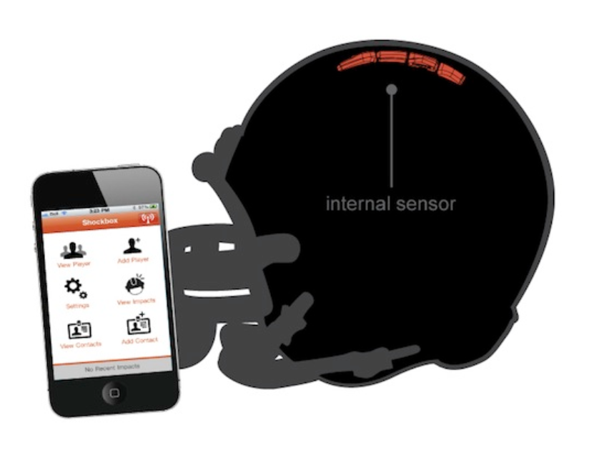
Helmet Integrated Impact
Detection System
(HI-IDS)
Presenter: Jasmine Arrieta
Role: Hardware Designer

Slide 2
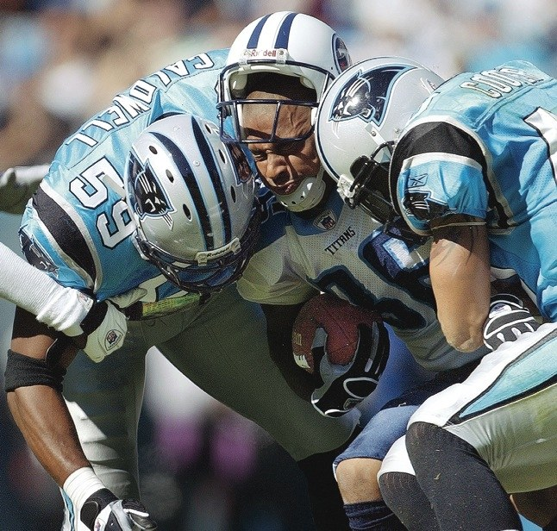
Concussions are a Serious Problem in Football !
Figure 1. NFL players making helmet on helmet contact.

Slide 3
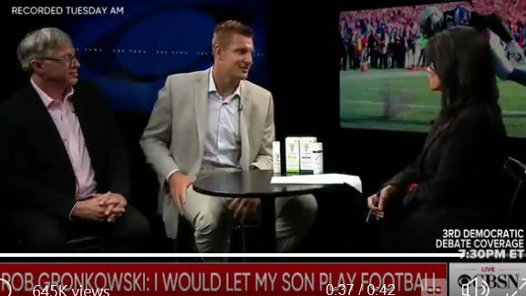
NFL Players Suffer Several Concussions
Figure 2. NFL player, Rob Gronkowski, admits he has suffered 20 concussions and 5 blackout moments.
Notes:
Sept.12,2019… New England Patriots, 5 blackouts

Slide 4
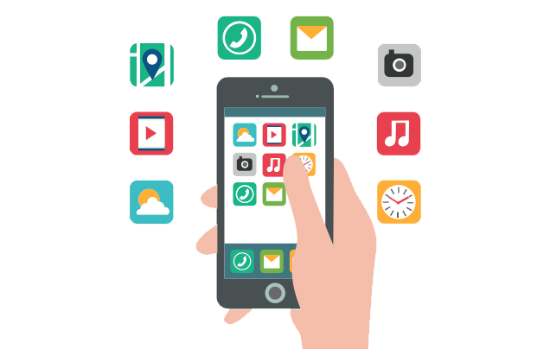

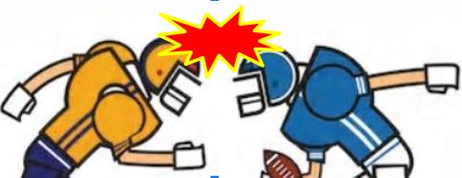
HI-IDS is Designed to Lower Brain
Damages in Players
Measures the g-force of collisions
Alerts coaches when a player is in danger of a concussion
Figure 3. Coaches monitoring players using mobile app. This will ensure coaches to receive alerts when players are injured.
Notes:
While at the same time … is durable and comfortable enough to be used like any regular football helmet
The software connect to the helmet will enable … to monitor…. And send alerts ..

Slide 5

Overview
Team
Hardware and Software Partitioning
Unit Requirements
Tracing Unit and System Requirements
Summary

Slide 6


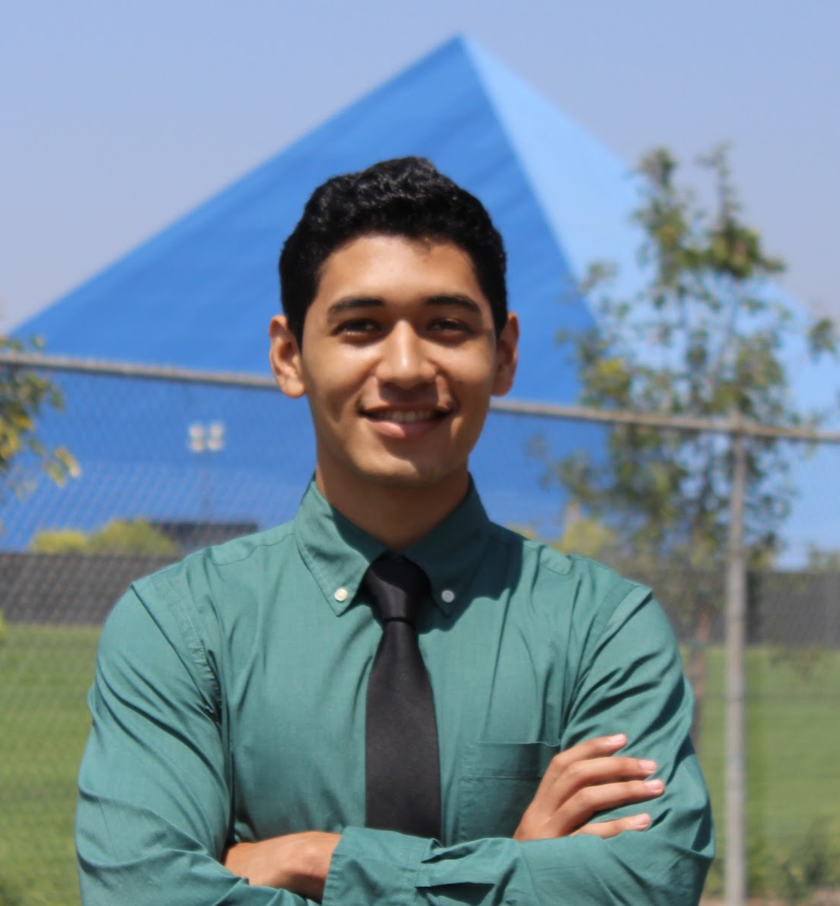
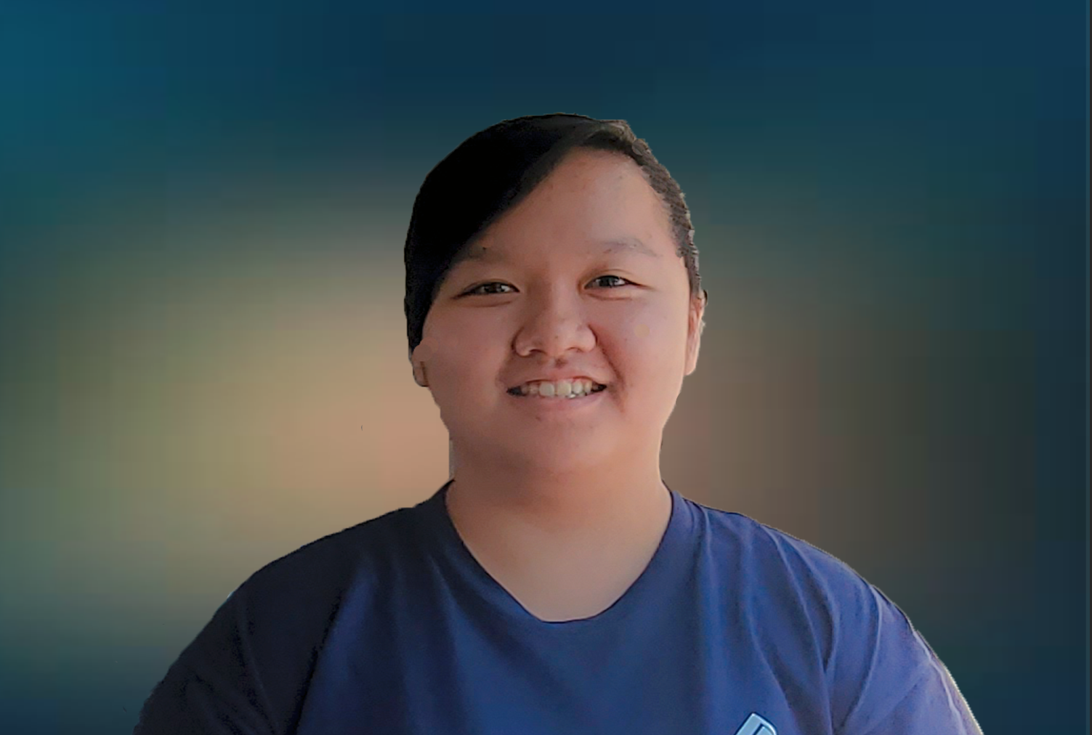
Members Qualification
Jasmine Arrieta
Role: Hardware Design
Emphasis: Electronics
Experience: 3D Printing, Creo, Python, Power Systems
Calvin Lee
Role: Software testing &
development
Emphasis: Communications
Experience: C++ / Python
Rhyan Gonzalez
Role: Hardware Design
Emphasis: Electronics
Experience: C++, VHDL, Matlab
Socheath Sok
Role: Software Design
Emphasis: BME
Experience: MATLAB, Simulink, VHDL, & Assembly

Slide 7
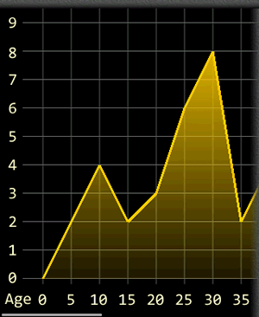
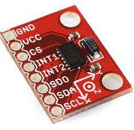
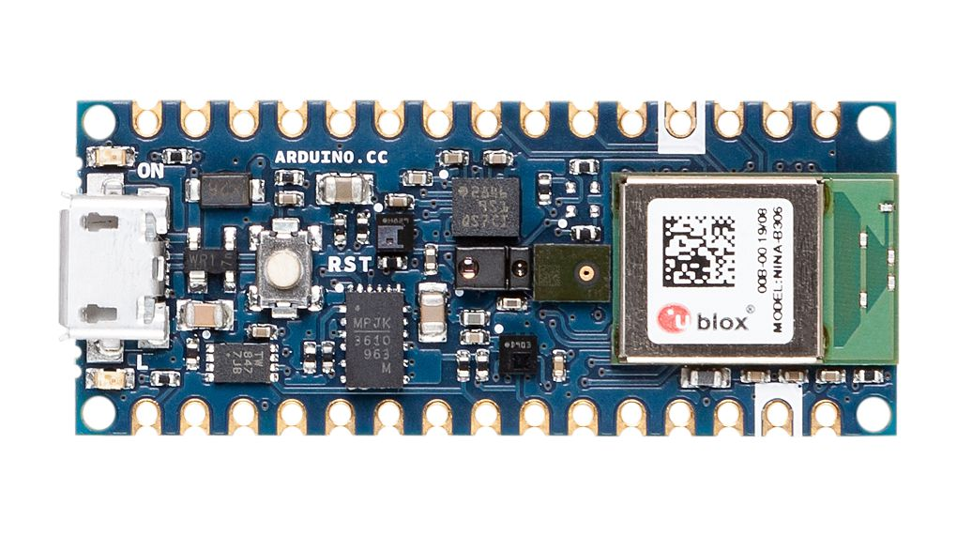
Partitioning The System
Hardware
Software

Slide 8
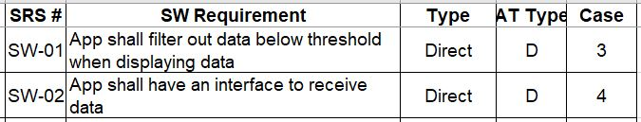
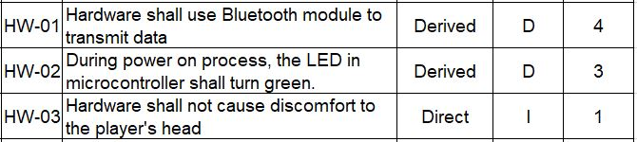
Identifying Hardware Requirement

Slide 9
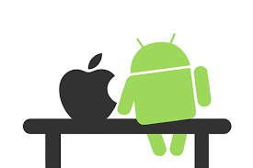
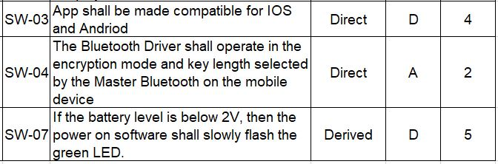

Identifying Software Requirements

Slide 10
Show
Requirements Trace

Slide 11
Concussions are a Serious Problem in Football !
Figure 1. NFL players making helmet on helmet contact

Slide 12
HI-IDS is Designed to Lower Brain
Damages in Players
Measures the g-force of collisions
Alerts coaches when a player is in danger of a concussion
Figure 3. Coaches monitoring players using mobile app. This will ensure coaches to receive alerts when players are injured.
Notes:
While at the same time … is durable and comfortable enough to be used like any regular football helmet
The software connect to the helmet will enable … to monitor…. And send alerts ..

Slide 13

Questions?

